Slide 1

Practice Your Programming with Katas
Session 2: Fibbing, maybe even recursively

Slide 2

Week 2: The Fibonacci Sequence http://eca-katas/session2
The Fibonacci sequence is a sequence of numbers starting 0,1. Each subsequent number consists of the previous two added together, so the sequence reads: 0,1,1,2,3,5,8….
Write a function, fibonacci() that accepts:
A number
It should return:
The number occupying that space in the Fibonacci sequence:
fibonacci(1) returns ‘1’
fibonacci(6) returns ‘8’
fibonacci() of a negative number is assumed to be 0

Slide 3
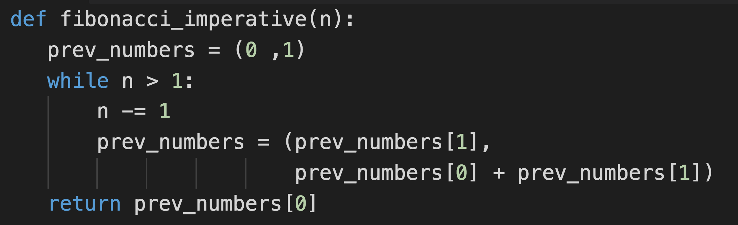
The Imperative Solution (BORING!)

Slide 4
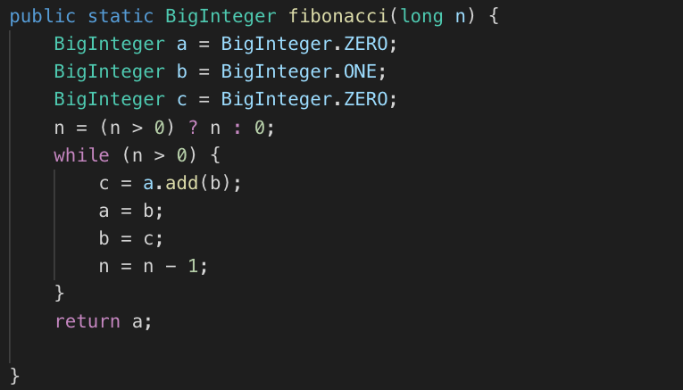
Imperative Java
Notes:
The ternary in there is *completely* unnecessary!

Slide 5
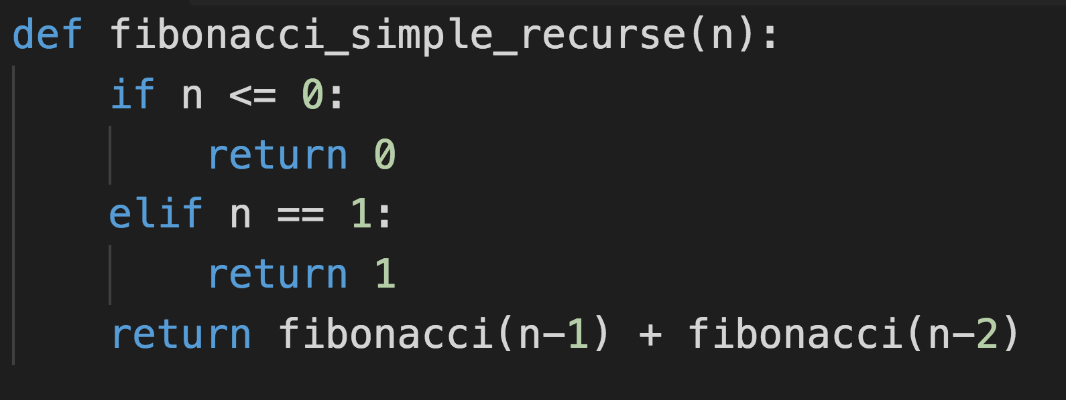
Simple… too simple

Slide 6
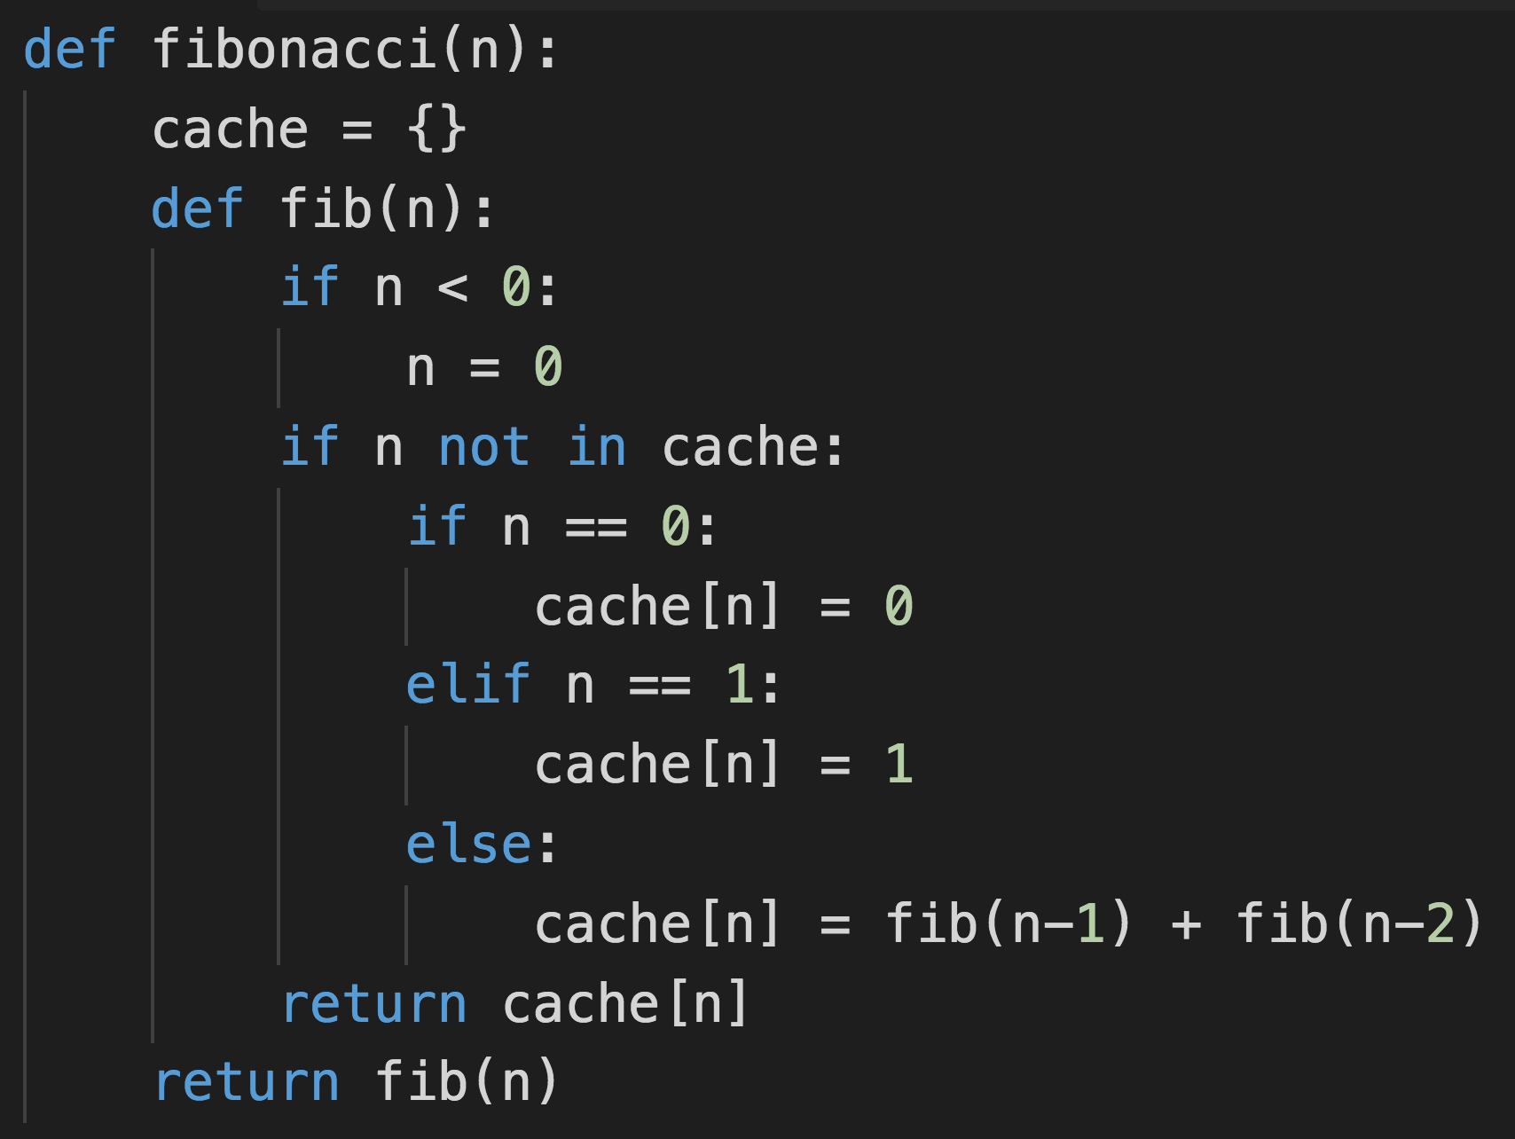
Crowbarring in a cache

Slide 7
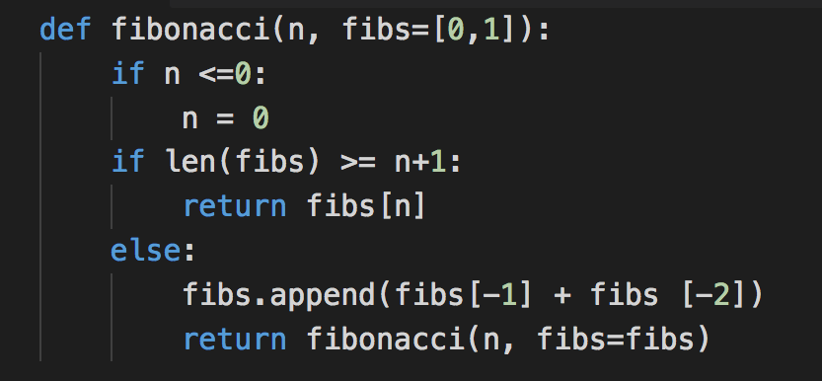
Default named parameters

Slide 8
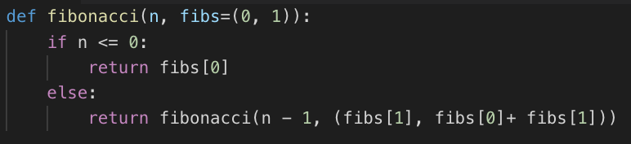
Somewhat more sensible?

Slide 9
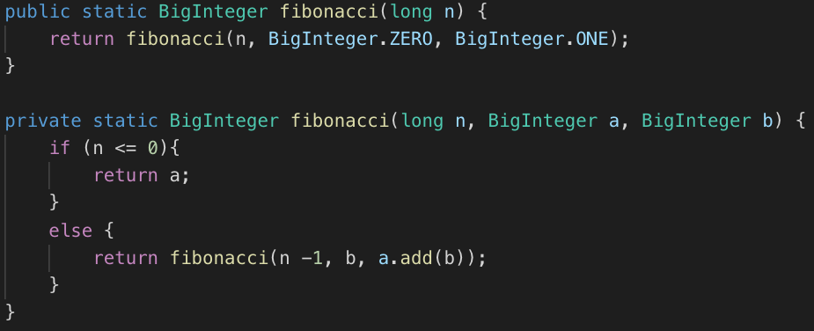
Tail Recursion, Java-style

Slide 10
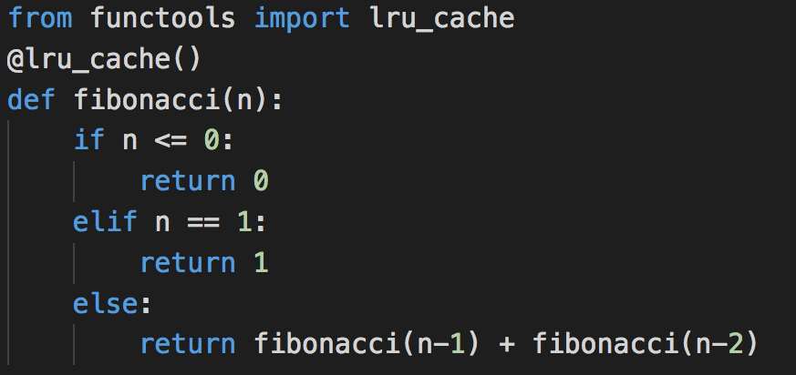
import antigravity
Decorators are fun! In Java we can use the @Cachable annotation from Spring for the same effect.

Slide 11
Next Week
Back to the 90s! (Beepity beep beep. Beep Beep beep.)

